Slide 1
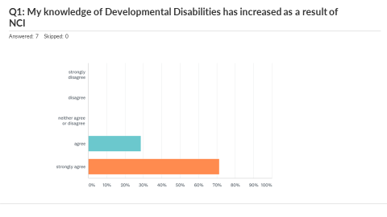
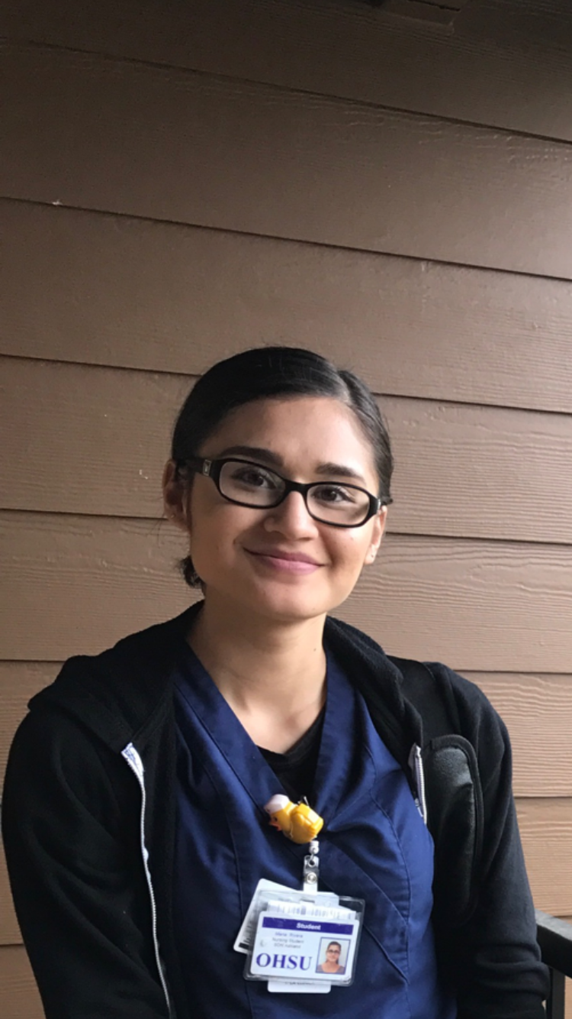
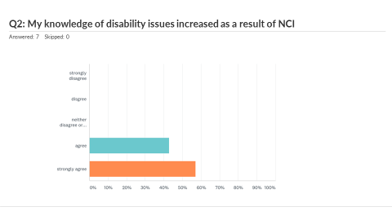
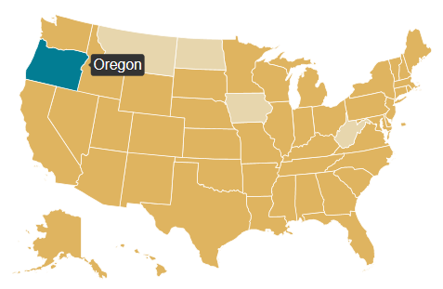
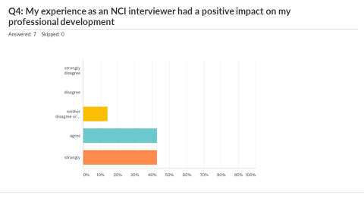
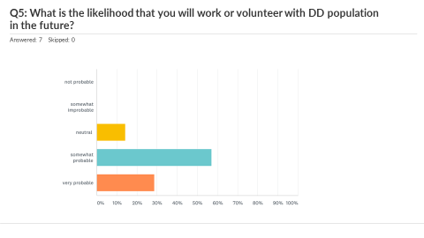
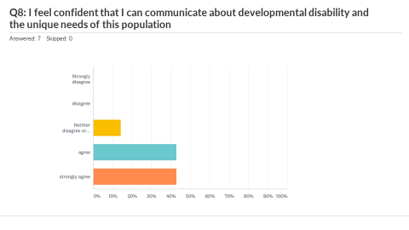
Evaluating the Impact of Research Assistant Positions with National Core Indicators (NCI)
on Emerging Professionals and the Developmental Disability Workforce
Alice Miller, MSW, MPH; Rhonda Eppelsheimer, LCSW; Jennifer Hoskins, LEND Social Work Fellow, Gaby Swisher, B.S.
Background
The National Core Indicators (NCI) assessment tool is widely used to assess the outcomes and inform service improvement of support services for people with developmental disabilities and their families. The University Center for Excellence in Developmental Disabilities (UCEDD) at Oregon Health & Science University (OHSU) partners with Oregon Developmental Disability Services to conduct interviews with people enrolled in services across the state. Across the country, many UCEDDs partner with State Directors of Developmental Disability Services (NASSDDDS) and the Human Services Research Institute (HSRI) to conduct NCI interviews. Research Assistants at OHSU travel the state and survey participants in their communities. These research assistants are often graduate students, recent graduates, and people from within the developmental disability community. Through NCI, the UCEDD is able to offer flexible research positions for graduate students and recent graduates in nursing, social work, public health, and other disciplines. Many interviewers describe their experience as NCI surveyors as a formative experience in their careers.
Research Questions
What is the impact of conducting NCI interviews on surveyors?
Does the experience of conducting interviews have an impact on the professional development of emerging professionals?
Methods
Surveyors filled out survey online and participated in an in-person trainee debrief and 1:1 exit interviews. Surveyor Feedback was then reviewed and grouped by theme. Select survey responses and quotes from recorded sessions are presented here.
Surveyor Debrief Themes
Gaining Knowledge, Skill Building & Application
“This project has helped me personally learn the difficulties individuals with disability face (not enough resources, insurance coverage difficulties, isolation, potential for abuse). It will help me as a nurse and future family nurse practitioner in understanding how to work with and communicate with individuals and families with disabilities”
“The most important thing I learned about via the NCI project was how important the supports that individuals with disabilities receive. I also learned how any disruption to these services can affect their lives in a deeply negative way.”
“I learned that Individuals with developmental disabilities can easily become isolated without access to the right resources.”
“The most important thing I learned was how crucial Medicaid is to individuals with disabilities and their families.”
Inclusion of DD community needs in future work
”I gained experience with a population I had little knowledge of prior to the project. As a social worker and public health professional, it is important for me to have an understanding of the unique needs of the disability community.”
“I will be more likely to consider the impact of any policy/practice on the disability community.”
“I hope to have a long career in DD services and assume that the NCI experience will provide an early foundation.”
“NCI has exposed me to the barriers that limit housing opportunities for people with developmental disabilities. I'd like to work with DD population and their access to safe affordable housing.”
Consumer Voice & Advocacy
“I learned that giving people a voice gives them power and control over their lives when they may not otherwise have had the opportunity to express their feelings and concerns.”
“NCI helped me to understand the importance of research and evaluation, and made me feel more comfortable with engaging in research projects. It also impressed the importance of centering consumer voice and feedback in all of my future work.”
“The NCI project highlighted the importance of paying special attention to the needs of individuals with disabilities when doing any work, and making adjustments to that work to make it accessible for everyone.”
Research Assistant Survey Responses
Looking Forward to NCI 17/18
Continue recruitment through graduate programs and alumni networks as well as family networks
Continue to facilitate mentor type relationships with Research Assistants
Continue to include education about disability in NCI training and throughout data collection
Further evaluation on impact next year
Follow up with former NCI interviewers
Surveyor Profile 2016-2017
Source: nationacoreindicators.org
2016-17 Survey Team Profile
Previous Experience
Non-profit project management
Program Management
Evaluation
Parents, including a parent of a child with developmental disability
Direct Care
Peace Corps Alum
Habitat for Humanity bookkeeper
Case Management
Mental Health Research
Career goals
Graduate Students and Recent Graduates
Public Health (MPH)
Social Work (MSW)
Urban and Regional Planning (MA)
Nursing (FNP)
Public Administration (MPA)
Nonprofit Management (Graduate Certificate)
Affordable Housing Advocates
Migrant Families Health Research
Future LEND Trainee in Social Work
For More Information
Alice Miller, Longley@ohsu.edu
Notes:
To do:
Data visuali

